Slide 1

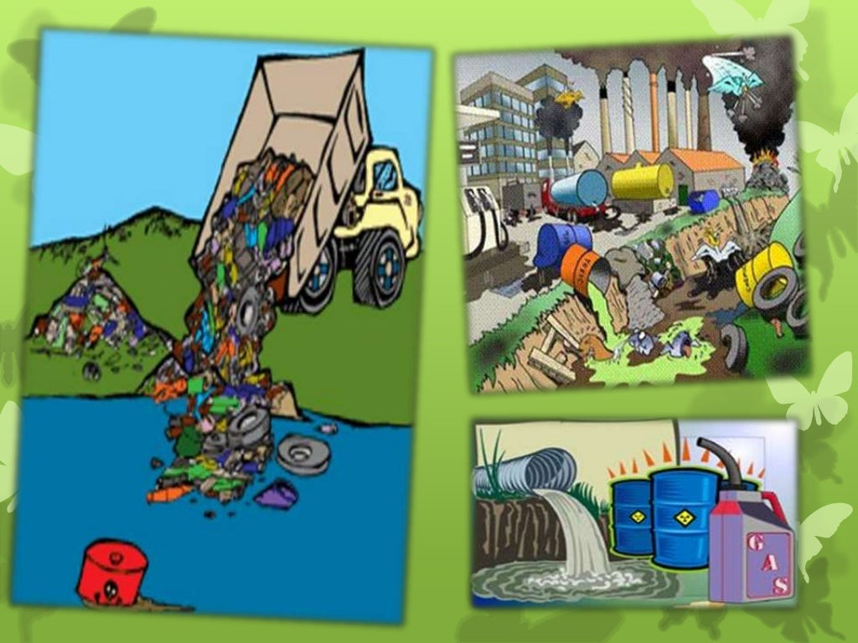
CHE 110 PROJECT
Sources of water pollution and methods to control them
Done by:
P.Shashikanth Reddy-12210906
M.Mukil-12217062
S.Rishith Reddy-12207770

Slide 2
Introduction:
Water pollution can be defined as the contamination of water bodies. Water pollution is caused when water bodies such as rivers, lakes, oceans, groundwater and aquifers get contaminated with industrial and agricultural effluents. One of the primary causes of water pollution is the contamination of water bodies by toxic chemicals. As seen in the example mentioned above, the dumped plastic bottles, tins, water cans and other wastes pollute the water bodies. These result in water pollution, which harms not just humans, but the whole ecosystem. Toxins drained from these pollutants, travel up to the food chain and eventually affect humans. Nearly 6 billion kilograms of garbage is dumped every year in the oceans. Apart from industrial effluents and untreated sewage, other forms of unwanted materials are dumped into various water bodies. This is the result of dumping garbage and toxic chemicals by industrial and commercial establishments Water pollution drastically affects aquatic life. This chemical is bioaccumulated in fish, chicken and meat. Most water pollution doesn't begin in the water itself. When farmers fertilize the fields, the chemicals they use are gradually washed by rain into the groundwater or surface waters nearby.

Slide 3
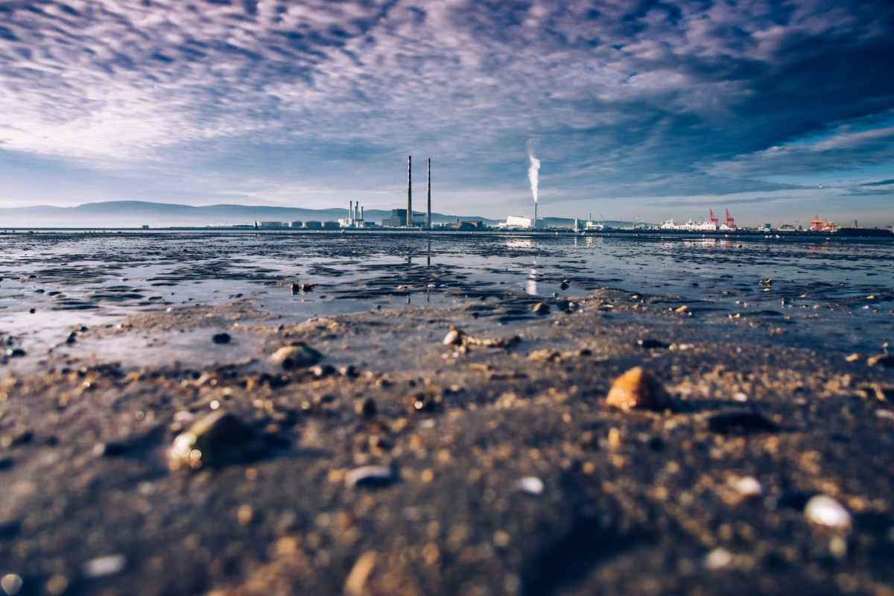
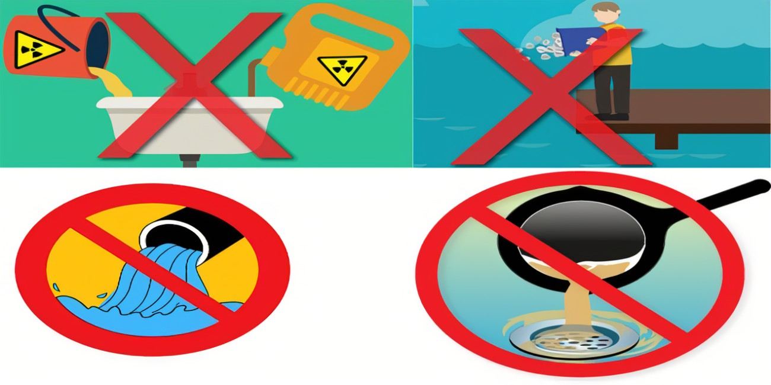
Goals and objectives:
Promote Environmental, Economic and Social Sustainability
Improve water supply reliability and quality
Protection of groundwater resources from contamination
Create, protect, enhance and maintain environmental resources and habitats
Provide clean, safe, reliable drinking water.
Increase recycled water use.
Promote Materials Management and Waste Management and Clean Sites
Promote Materials Management, Waste Management, and Clean Sites

Slide 4

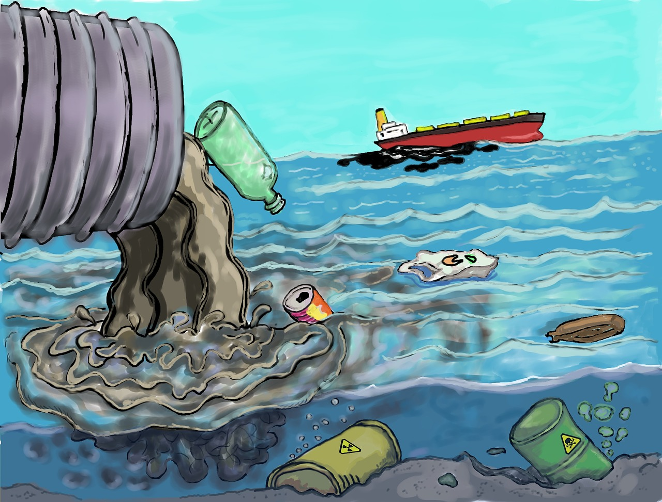

Causes of water pollution
One of the primary causes of water pollution is the disposal of sewage in bodies of water.
Global warming causes water temperatures to rise, which can kill water-dwelling animals.
In order to protect their crops from bacteria and insects, farmers often use chemicals and pesticides they can harm animals, plants and humans which then flows into rivers and streams that filter into the ocean, causing further water pollution.
The process of marine dumping is exactly what it sounds like, dumping garbage into the waters of the ocean.
Industries produce waste in the form of toxic chemicals and pollutants are a major contributor to water pollution.

Slide 5
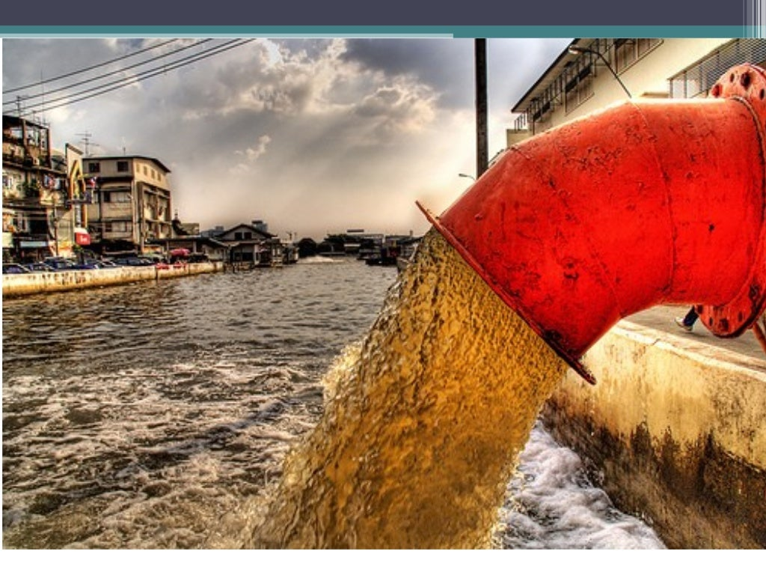
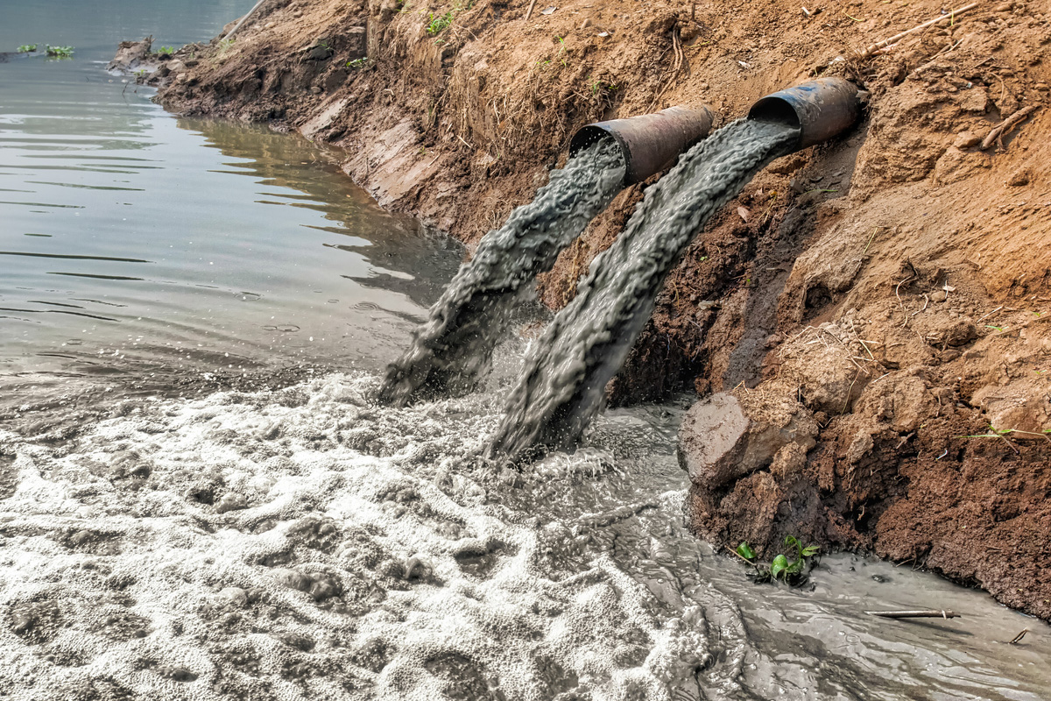
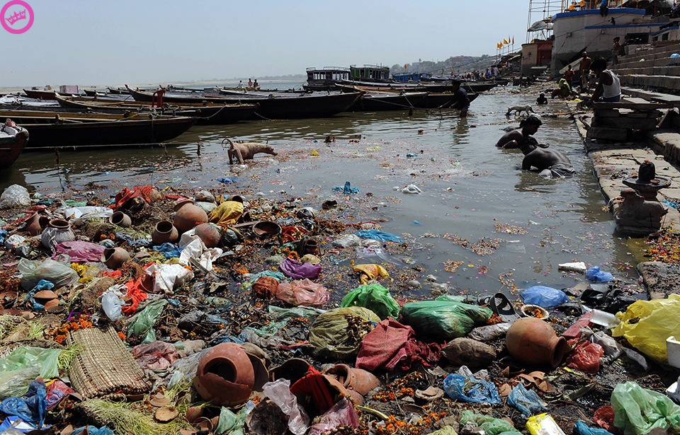
Control Measures of Water Pollution:
Reduction of direct industrial discharge volumes into the municipal sewer system.
Use of fertilizers and insecticides in excess should be avoided.
Chemical fertilizers can be replaced by organic farming and efficient use of animal waste as fertilizer.
Water hyacinth (an aquatic weed and an invasive plant) can purify water by removing harmful compounds and heavy metals.
It has been suggested that eucalyptus trees be planted everywhere along sewage ponds. These trees quickly absorb excess wastewater and emit pure water vapour into the atmosphere.

Slide 6
Conclusion:
Water pollution is not less dangerous than air and soil pollution. All of them are negatively affect the lives of humans and animals alike.
Directly and indirectly, water is polluted with germs, solid, and liquid wastes. These pollutants change its color, taste and aroma and make it unfit for consumption.
There are many types of water pollutants. The most important are physical, chemical, biological, and radiological pollution. All these types are very dangerous, and causing several diseases to humans, animals and plants
Thank you

